Slide 1
INFO-3135
Graphs

Slide 2
Graphs
A graph is a way of representing relationships that exist between pairs of objects.
That is, a graph is a set of objects, called vertices, together with a collection of pairwise connections between them.
Graphs have applications in mapping, transportation, electrical engineering, and computer networks.
Viewed abstractly, a graph G is simply a set N of Nodes and a collection E of pairs of vertices from N, called edges.
  Therefore, a graph is a way of representing connections or relationships between pairs of objects from some set N.
  There is no limit to the number of Nodes or the edges between them

Slide 3
Graphs
Edges in a graph are either directed or undirected.
An edge (u,v) is said to be directed from u to v if the pair (u,v) is ordered, with u preceding v.
An edge (u,v) is said to be undirected if the pair (u,v) is not ordered.
Undirected edges are sometimes denoted with set notation, as {u,v}
Graphs are typically visualized by drawing the vertices as ovals or rectangles and the edges as segments or curves connecting pairs of ovals and rectangles.

Slide 4
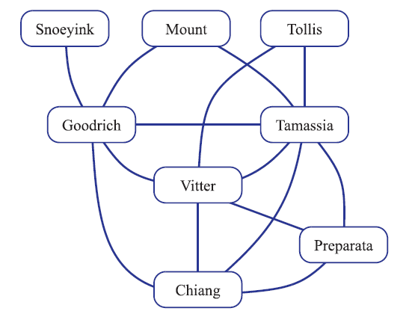
Graphs
We can visualize collaborations among researchers of a certain discipline by creating a graph whose
Nodes are associated with the researchers themselves
Edges connect pairs of Nodes associated with researchers who have co-authored a paper or book.
These edges are undirected because co-authorship is a symmetric relation; that is, if A has coauthored something with B, then B has coauthored something with A.

Slide 5
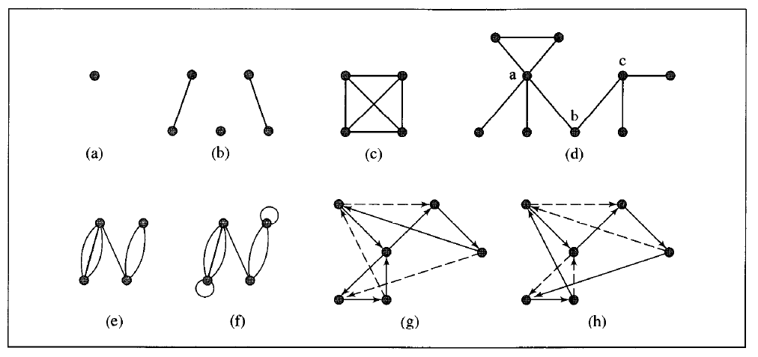
Examples of Graphs

Slide 6
Representing Graphs
There three popular ways of representing graphs, which are usually referred to as the :
  edge list structure
  adjacency list structure
  adjacency matrix. or incidence matrix
All three representations, we use a collection to store the vertices
of the graph.
Regarding the edges, there is a difference between the first two structures and the last.
The edge list structure and the adjacency list structure only store the edges actually present in the graph, while the adjacency matrix stores a placeholder for every pair of vertices (whether there is an edge between them or not).

Slide 7
The Edge List Structure
The edge list structure the simplest, though not the most efficient, representation of a graph G.
In this representation, a Node N of G storing an element x is explicitly represented by a Node object.
All such Node objects are stored in a collection V, such as a vector or list. We can think of the nodes being numbered
Node Objects
The object for a node N storing element x has member variables for:
  A copy of x
  The position (or entry) of the vertex-object in collection V
The distinguishing feature of the edge list structure is the way in which it represents edges.
In this structure, an edge E of G storing an element x is explicitly represented by an edge object. The edge objects are stored in a collection E, which would typically be a vector or list.

Slide 8
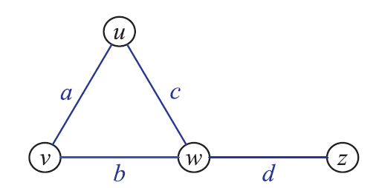
The Edge List Structure
Edge Objects
The edge object for an edge e storing element x has member variables for:
A copy of x
The vertex positions associated with the endpoint vertices of e
The position (or entry) of the edge-object in collection E

Slide 9
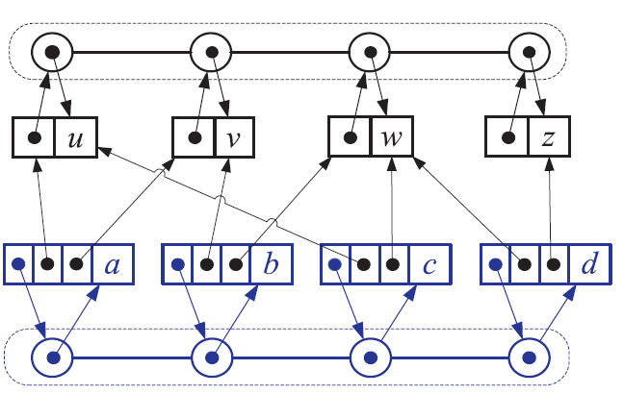
The Edge List Structure
List of Nodes
The reason this structure is called the edge list structure is that the simplest and most common implementation of the edge collection E is by using a list.
The main feature of the edge list structure is that it provides direct access from edges to the nodes they are incident upon.
List of Edges

Slide 10
Let’s compare side by side
List of Nodes
List of Edges

Slide 11
The Adjacency List Structure
The adjacency list structure for a graph G adds extra information to the edge list structure that supports direct access to the incident edges (and thus to the adjacent nodes) of each node.
This approach allows us to implement several functions of the graph much faster than what is possible with the edge list structure, even though both of these two representations use an amount of space proportional to the number of vertices and edges in the graph.
The adjacency list structure includes all the structural components of the edge list structure plus the following:
  A node object v holds a reference to a collection I(v), called the incidence collection of v, whose elements store references to the edges incident on v.
  The edge object for an edge e with end nodes v and w holds references to the positions (or entries) associated with edge e in the incidence collections I(v) and I(w).

Slide 12
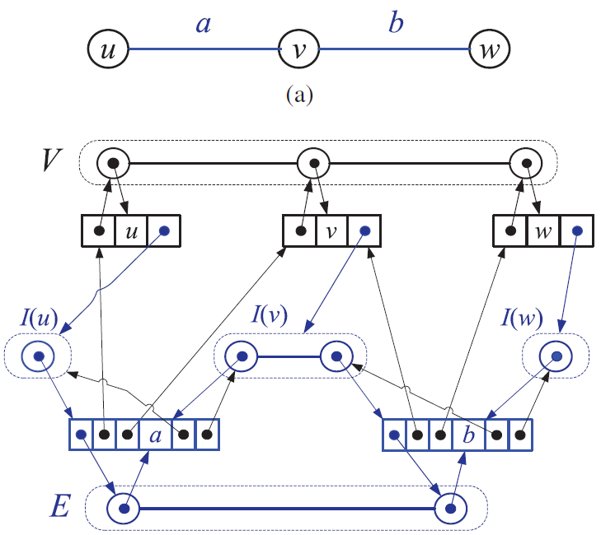
The Adjacency List Structure
The incidence collection I(v) for a vertex v is a list, which is why we call this way of representing a graph the adjacency list structure. The adjacency list structure provides direct access both from the edges to the vertices and from the vertices to their incident edges.

Slide 13
The Adjacency Matrix Structure
Like the adjacency list structure, the adjacency matrix structure of a graph also extends the edge list structure with an additional component.
We add a matrix (a two-dimensional array) A that allows us to determine adjacencies between pairs of nodes.
In the adjacency matrix representation, we think of the nodes as being the integers in the set {0,1, . . . ,n−1} and the edges as being pairs of such integers. This allows us to store references to edges in the cells of a two-dimensional n×n array A.
Specifically, the adjacency matrix representation extends the edge list structure as follows:
  A node object v stores a distinct integer i in the range 0,1, . . . ,n−1, called the index of v.
  We keep a two-dimensional n×n array A such that the cell A[i, j] holds a reference to the edge (v,w), if it exists, where v is the node with index i and w is the node with index j.
  If there is no such edge, then A[i, j] = null.

Slide 14
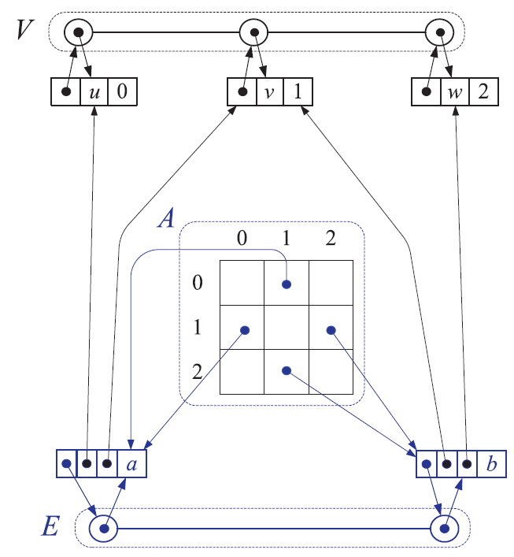

Adjacency Matrix Structure

Slide 15
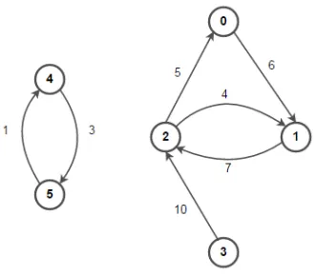
Weighted Graphs
In weighted graphs every edge will have a weight or cost associated with it.
A positive value assigned to each edge indicating its length (distance between the nodes connected by an edge) is called weight.
A graph containing weighted edges is called a weighted graph. The weight of an edge e is denoted by w(e) and it indicates the cost of traversing an edge.

Slide 16
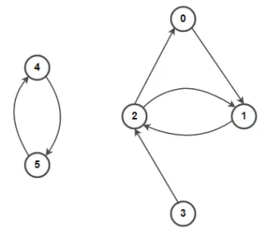
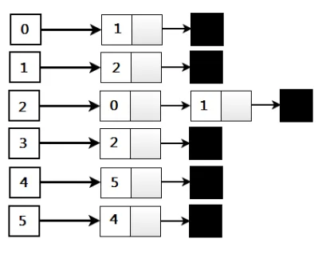
Adjacency List Implementation
becomes

Slide 17
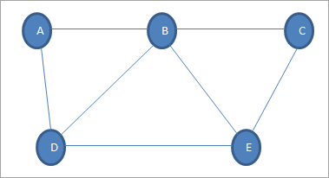
Undirected Graphs
Graph G is a set of nodes {A,B,C,D,E}
and a set of edges {(A,B),(B,C),(A,D),(D,E),(E,C),(B,E),(B,D)}

Slide 18
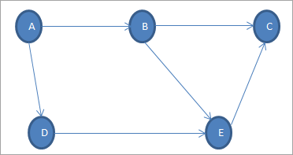
Directed Graphs
Edges form an ordered pair where each edge represents a specific path from one node to another node.
The node from which the path initiates is called “Initial Node” while the node into which the path terminates is called the “Terminal Node”.
In above graph, the set of nodes is
(A, B, C, D, E)
and the set of edges is ((A,B),(A,D),(B,C),(B,E),(D,E)(E,C))

Slide 19
Traversing Graphs
As in trees, traversing a graph consists of visiting each node only one time.
The simple traversal algorithms used for trees cannot be applied here because graphs may include cycles; which would result in infinite loops.
To prevent that from happening, each visited node can be marked to avoid revisiting it.
However, graphs can have isolated nodes, which means that some parts of the graph are left out if unmodified tree traversal methods are applied.

Slide 20
Depth-First Traversal
Each node v is visited and then each unvisited node adjacent to v is visited.
If a node v has no adjacent nodes or all of its adjacent nodes have been visited, we backtrack to the predecessor of v.
The traversal is finished if this visiting and backtracking process leads to the first node where the traversal started.
If there are still some unvisited nodes in the graph, the traversal continues restarting for one of the unvisited nodes.
So - whenever a node v is visited during this traversal, we will recursively visit all of v 's unvisited neighbors.
We will add all edges leading out of v to a stack. The next node to be visited is determined by popping the stack and following that edge.
The effect is to follow one branch through the graph to its conclusion, then it will back up and follow another branch, and so on.
Depth-First can be applied to directed or undirected graphs.

Slide 21
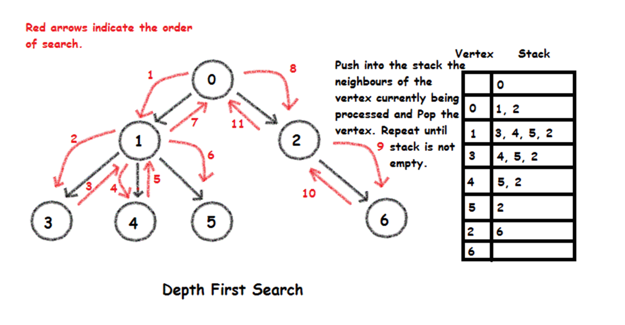
Depth First
A common implementation uses a stack to keep track of nodes already visited.

Slide 22
Breadth-First Traversal
This examines all nodes connected to the start node before visiting nodes further away.
Breadth-First is implemented similarly to Depth-First, except that a queue replaces the recursion stack.
Note that if the graph is a tree and the start node is at the root, Breadth-First is equivalent to visiting nodes level by level from top to bottom.

Slide 23
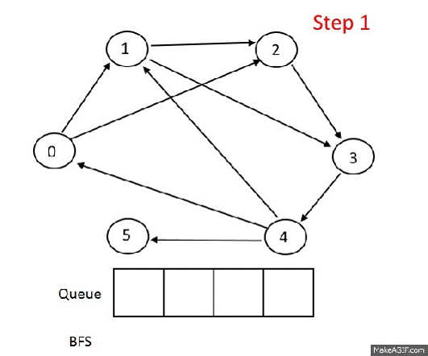
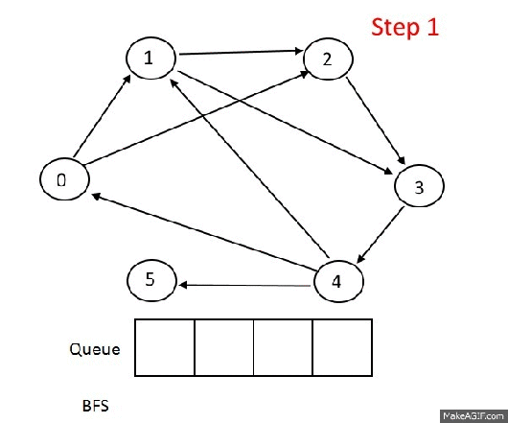
Breadth First
Breadth-first traversal uses a queue as the basic data structure to navigate the nodes
BFS first tries to mark all neighbors of a node v before proceeding to other nodes

Slide 24
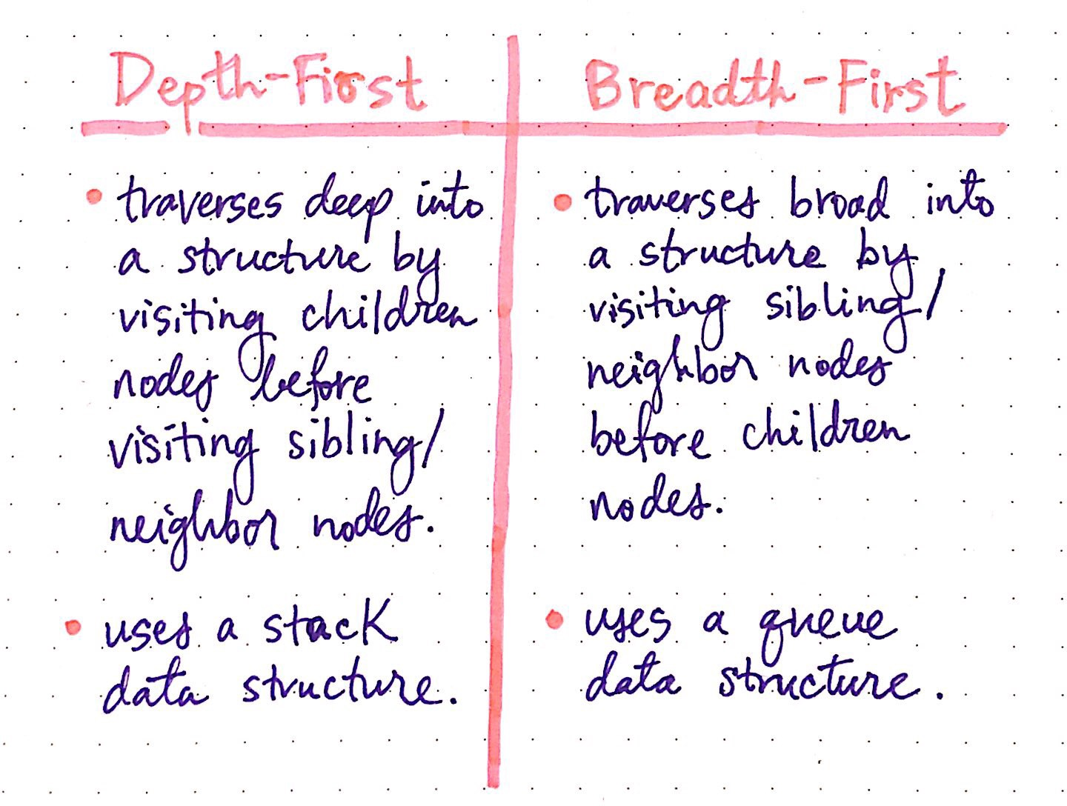
Review Traversals
https://medium.com/basecs/going-broad-in-a-graph-bfs-traversal-959bd1a09255

